Slide 1


Search for an exotic Higgs boson decay to two pseudoscalar bosons with a four photon final state Oral Candidacy Proposal December 13, 2023
Sergi Castells
Advisors: Colin Jessop and Nancy Marinelli

Slide 2
Outline
Introduction
The Standard Model and Beyond
LHC and CMS
Sample Generation
Event Selection
Statistical Analysis
Advancements on Previous Studies
Summary
Notes:
Introduction – what am I doing? Basic why is it interesting?
The Standard Model and Beyond – theory stuff
LHC and CMS – also mention service work here briefly
Sample Generation – signal MC and event mixing part
Event Selection – cuts, BDT, categorization
Statistical Analysis – signal modelling + note on background fits
Advancements on Previous Studies – exactly what it sounds like
Summary – put everything together for questions
REMEMBER TO INCLUDE PLOTS!!!!!!!

Slide 3
Introduction
Why do this analysis?
Why is it interesting?
Basically copy some of my intro from the proposal paper
Quick overview of what I’m doing now, i.e., proof-of-concept for 2018 Run 2 portion of old analysis and then Run 3

Slide 4
Outline
Introduction
The Standard Model and Beyond
LHC and CMS
Sample Generation
Event Selection
Statistical Analysis
Advancements on Previous Studies
Summary
Notes:
Introduction – what am I doing? Basic why is it interesting?
The Standard Model and Beyond – theory stuff
LHC and CMS – also mention service work here briefly
Sample Generation – signal MC and event mixing part
Event Selection – cuts, BDT, categorization
Statistical Analysis – signal modelling + note on background fits
Advancements on Previous Studies – exactly what it sounds like
Summary – put everything together for questions
REMEMBER TO INCLUDE PLOTS!!!!!!!

Slide 5
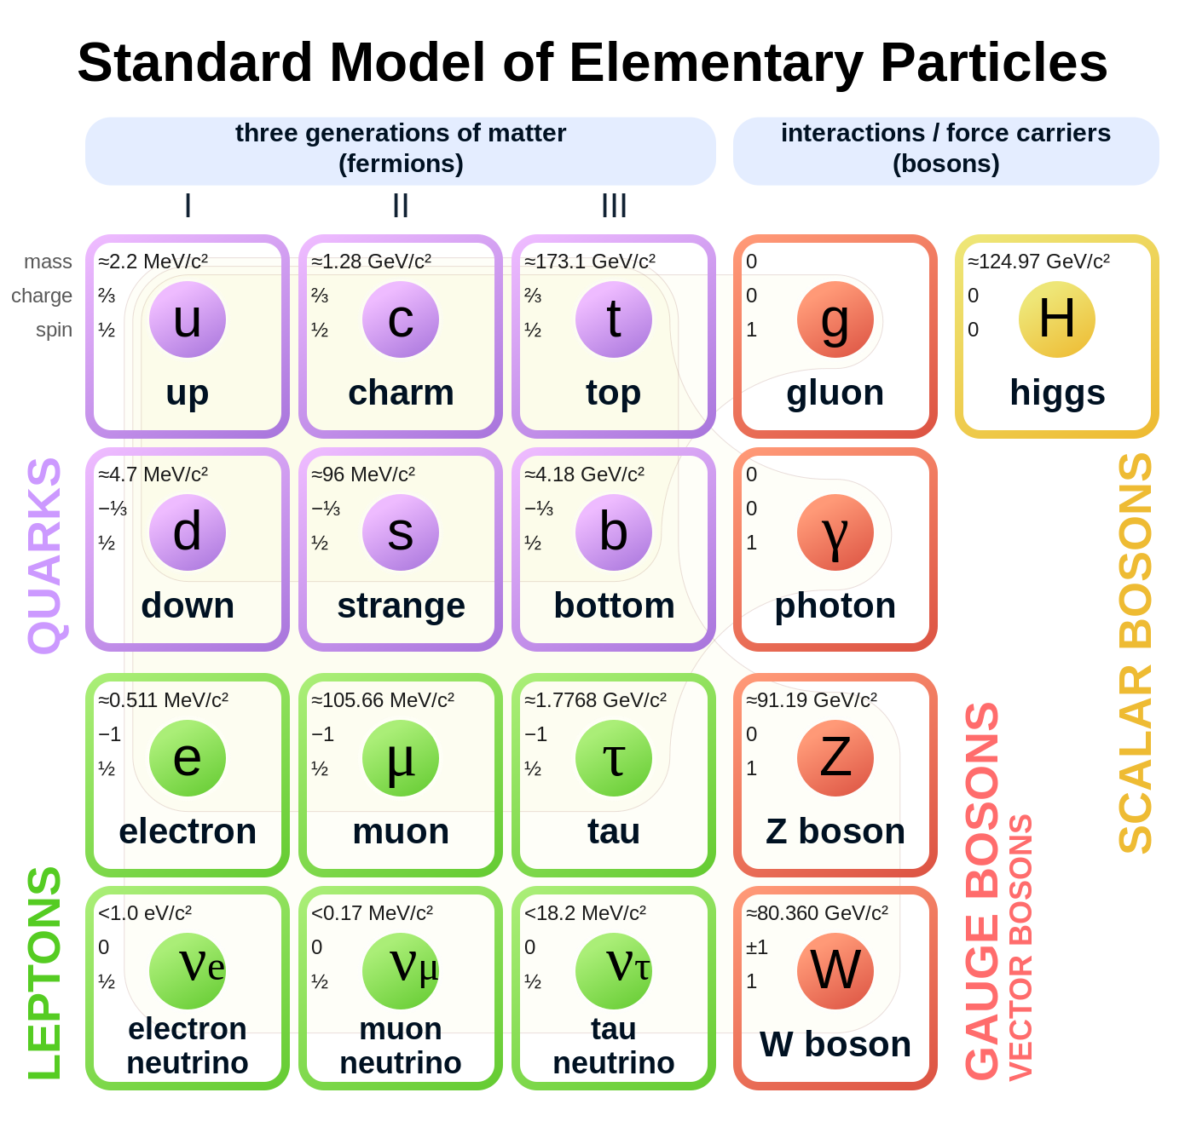
The Standard Model
Basics…
Higgs Sector
EWSB
Higgs Mechanism – boson masses
Higgs VEV + Yukawa coupling – other particle masses

Slide 6

Extended Higgs Sectors
Various models with extended Higgs sectors
Difference in phenomenologies
No FCNC -> Z2 symmetries
Rho parameter + maintaining = 1 & Restrictions in (T_3, Y) for rho = 1
E.g. triplets need contrived VEV for rho $∼=$ 1

Slide 7
Outline
Introduction
The Standard Model and Beyond
LHC and CMS
Sample Generation
Event Selection
Statistical Analysis
Advancements on Previous Studies
Summary
Notes:
Introduction – what am I doing? Basic why is it interesting?
The Standard Model and Beyond – theory stuff
LHC and CMS – also mention service work here briefly
Sample Generation – signal MC and event mixing part
Event Selection – cuts, BDT, categorization
Statistical Analysis – signal modelling + note on background fits
Advancements on Previous Studies – exactly what it sounds like
Summary – put everything together for questions
REMEMBER TO INCLUDE PLOTS!!!!!!!

Slide 8
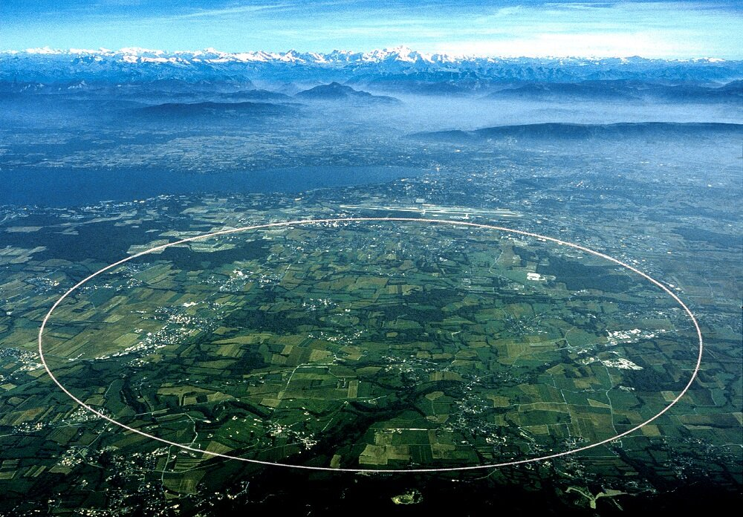
The Large Hadron Collider (LHC)
Details about energy, luminosity, magnets, size, etc.

Slide 9
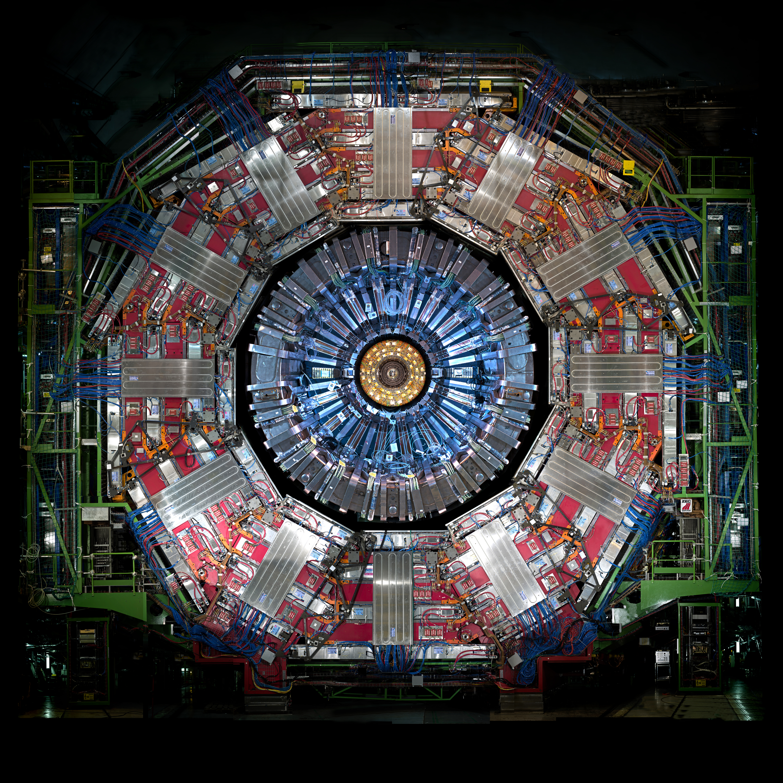
Compact Muon Solenoid (CMS)
Sub-detectors and what they do
Some extra notes about ECAL?
Note about my service work

Slide 10
Outline
Introduction
The Standard Model and Beyond
LHC and CMS
Sample Generation
Event Selection
Statistical Analysis
Advancements on Previous Studies
Summary
Notes:
Introduction – what am I doing? Basic why is it interesting?
The Standard Model and Beyond – theory stuff
LHC and CMS – also mention service work here briefly
Sample Generation – signal MC and event mixing part
Event Selection – cuts, BDT, categorization
Statistical Analysis – signal modelling + note on background fits
Advancements on Previous Studies – exactly what it sounds like
Summary – put everything together for questions
REMEMBER TO INCLUDE PLOTS!!!!!!!

Slide 11
Sample Generation
How the signal MC was made – also the conversions are probably important given the current setup
Why not using MC for background?
Event mixing

Slide 12
Outline
Introduction
The Standard Model and Beyond
LHC and CMS
Sample Generation
Event Selection
Statistical Analysis
Advancements on Previous Studies
Summary
Notes:
Introduction – what am I doing? Basic why is it interesting?
The Standard Model and Beyond – theory stuff
LHC and CMS – also mention service work here briefly
Sample Generation – signal MC and event mixing part
Event Selection – cuts, BDT, categorization
Statistical Analysis – signal modelling + note on background fits
Advancements on Previous Studies – exactly what it sounds like
Summary – put everything together for questions
REMEMBER TO INCLUDE PLOTS!!!!!!!

Slide 13
Event Selection
Cuts and selections
Efficiencies?
4-photon BDT
Categorization optimization + cut?

Slide 14
Outline
Introduction
The Standard Model and Beyond
LHC and CMS
Sample Generation
Event Selection
Statistical Analysis
Advancements on Previous Studies
Summary
Notes:
Introduction – what am I doing? Basic why is it interesting?
The Standard Model and Beyond – theory stuff
LHC and CMS – also mention service work here briefly
Sample Generation – signal MC and event mixing part
Event Selection – cuts, BDT, categorization
Statistical Analysis – signal modelling + note on background fits
Advancements on Previous Studies – exactly what it sounds like
Summary – put everything together for questions
REMEMBER TO INCLUDE PLOTS!!!!!!!

Slide 15
Statistical Analysis
Signal modelling for nominal mass points (plot!)
Intermediate mass points – to do
Note about background modelling as nuisance parameter when extracting limits?
To do stuff, e.g., limit extraction

Slide 16
Outline
Introduction
The Standard Model and Beyond
LHC and CMS
Sample Generation
Event Selection
Statistical Analysis
Advancements on Previous Studies
Summary
Notes:
Introduction – what am I doing? Basic why is it interesting?
The Standard Model and Beyond – theory stuff
LHC and CMS – also mention service work here briefly
Sample Generation – signal MC and event mixing part
Event Selection – cuts, BDT, categorization
Statistical Analysis – signal modelling + note on background fits
Advancements on Previous Studies – exactly what it sounds like
Summary – put everything together for questions
REMEMBER TO INCLUDE PLOTS!!!!!!!

Slide 17
Advancements on Previous Studies
How to improve on the previous analysis…
More statistics if doing a Run 2 + partial Run 3
Deep learning model instead of a BDT (Keras network vs tree)
Better with lower-level variables. Still might be possible given the work done to add extra branches to the samples anyway
Improvement by sqrt(2) in precision from Run 2 → Run 3

Slide 18
Outline
Introduction
The Standard Model and Beyond
LHC and CMS
Sample Generation
Event Selection
Statistical Analysis
Advancements on Previous Studies
Summary
Notes:
Introduction – what am I doing? Basic why is it interesting?
The Standard Model and Beyond – theory stuff
LHC and CMS – also mention service work here briefly
Sample Generation – signal MC and event mixing part
Event Selection – cuts, BDT, categorization
Statistical Analysis – signal modelling + note on background fits
Advancements on Previous Studies – exactly what it sounds like
Summary – put everything together for questions
REMEMBER TO INCLUDE PLOTS!!!!!!!

Slide 19
Summary
Do this last?

Slide 20
Thank You!

Slide 21
Backup

